Slide 1
Introduction to Quantifying STEM-EDXS (XEDS) data
Tom Slater

Slide 2
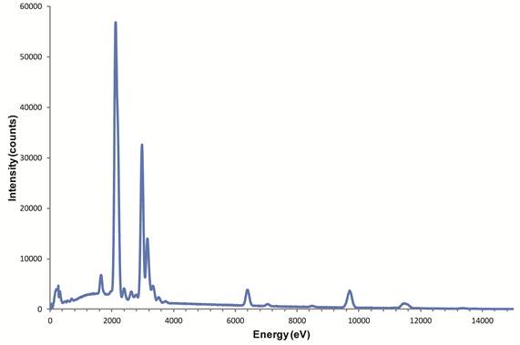
Introduction
How do you go from a set of X-ray peaks to the composition of your sample?

Slide 3
Introduction
Equation for X-ray intensity from sample in STEM-EDX
$$I_{α}=\left\{σ_{α}Γ_{α}ω_{α}\right\} n_{A}t \left\{ε_{α}\frac{Ω}{4π}\right\}N_{e}$$
X-ray generation
Sample specifics
Detector properties

Slide 4
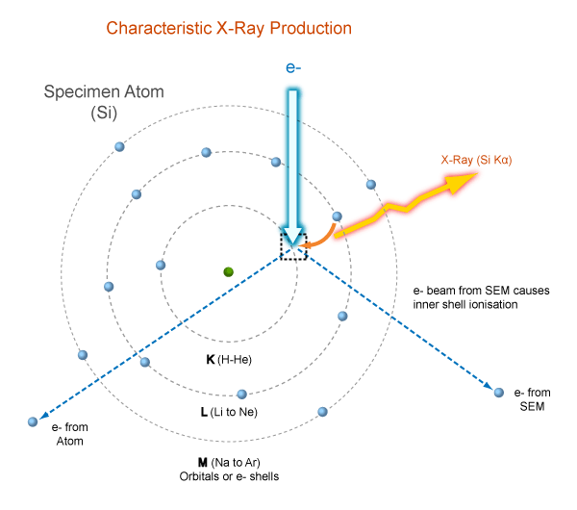
X-ray generation
$$\# inelastic scattering events= σ_{α}n_{A}N_{e}t$$
$σ_{α}=$ ionisation cross-section for α-shell of element A
$n_{A}=$ number density of atoms of element A
$N_{E}=$ incident number of electrons
$t=$ sample thickness

Slide 5
X-ray generation
$Γ_{α}$ for K X-rays
K_{α1} = 100
K_{α2} = 50
K_{β1} = 15-30
K_{β2} = 1-10
K_{β3} = 6-15
$$\# X−rays emitted=\{σ_{α}Γ_{α}ω_{α}\}n_{A}N_{e}t$$
$Γ_{α}=$ radiative partition function for α X-ray line
(proportion of transitions from the
particular sub-shell)
$ω_{α}=$ fluorescence yield (proportion of transitions
that result in X-ray emission (vs electron
emission))
Feldman & Mayer, Fundamentals of Surface and Thin Film Analysis

Slide 6
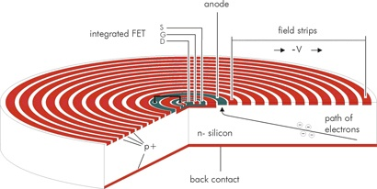
Detecting X-rays
Signal from FET
Current detector of choice – Silicon Drift Detector

Slide 7
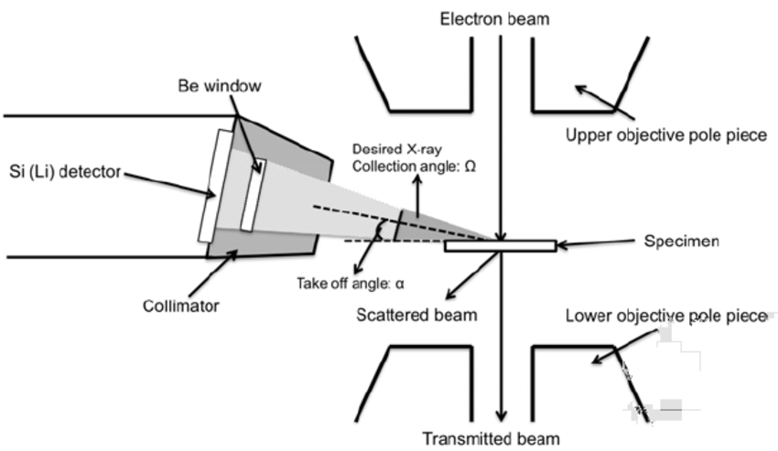
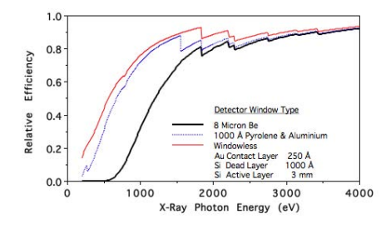
Detecting X-rays
$$\# X−rays detected=\{σ_{α}Γ_{α}ω_{α}\}n_{A}N_{e}t\left\{ε_{α}\frac{Ω}{4π}\right\}$$
$ε_{α}=$ Detector efficiency for X-rays of
energy equivalent to the α X-ray
$Ω=$ Collection solid angle

Slide 8
Quantification – Cliff-Lorimer
$C_{A}=$ Weight fraction of element A
$$\# X−rays detected=\{σ_{α}Γ_{α}ω_{α}\}n_{A}N_{e}t\left\{ε_{α}\frac{Ω}{4π}\right\}$$
$$n_{A}=\frac{C_{A}N_{0}ρ}{A_{A}}$$
$N_{0}=$ Avogadro’s number
$ρ=$ Density of sample
$A_{A}=$ Atomic weight of element A
$$I_{α}=\{σ_{α}Γ_{α}ω_{α}\}\left\{\frac{C_{A}N_{0}ρ}{A_{A}}\right\}N_{e}t\left\{ε_{α}\frac{Ω}{4π}\right\}$$
$$k_{AB}=\frac{\{σ_{α}Γ_{α}ω_{α}\}\left\{\frac{1}{A_{A}}\right\}ε_{α}}{\{σ_{β}Γ_{β}ω_{β}\}\left\{\frac{1}{A_{B}}\right\}ε_{β}}$$
$$\frac{C_{A}}{C_{B}}=k_{AB}\frac{I_{A}}{I_{B}}$$
Cliff & Lorimer’s well known equation!
Don’t worry about this one!
Cliff & Lorimer J. Microsc. (1975) 103, 203-207
Watanabe & Williams J. Microsc. (2006) 221, 89-109

Slide 9
How do we get Cliff Lorimer k-factors?
Calculate
Measure
$$k_{AB}=\frac{\{σ_{α}Γ_{α}ω_{α}\}\left\{\frac{1}{A_{A}}\right\}ε_{α}}{\{σ_{β}Γ_{β}ω_{β}\}\left\{\frac{1}{A_{B}}\right\}ε_{β}}$$
Get a standard sample and measure!
Your standard needs to:
Contain the elements you would like to measure.
Be a single known phase.
Not change composition due to electron beam damage.
Be sufficiently thin not to worry about absorption correction.
Can be tricky to get a suitable standard.
Need a reliable cross-section and detector efficiency in order to get an accurate answer.
Usually quoted to be accurate to ±10% for K peaks and ±20% for L peaks. Difficult for M peaks!

Slide 10
Workflow for quantifying EDX/S data
Get spectrum (can be individual spectrum or many spectra as in a spectrum image).
Get intensity in each X-ray peak of interest with background subtracted.
Apply quantification using Cliff-Lorimer approach with known k-factors.

Slide 11
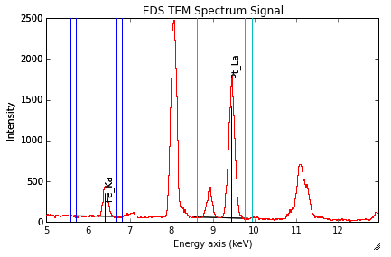
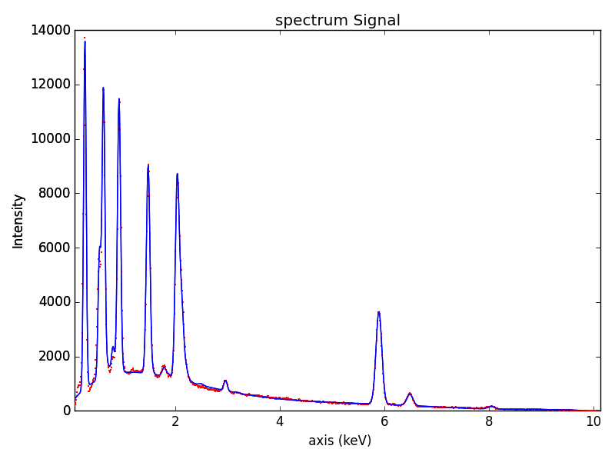
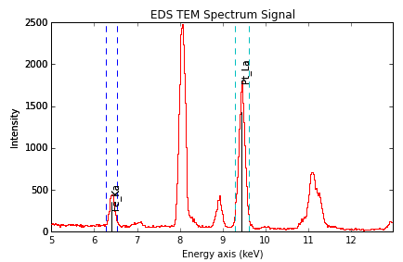
Hyperspy – Getting Intensities

Slide 12
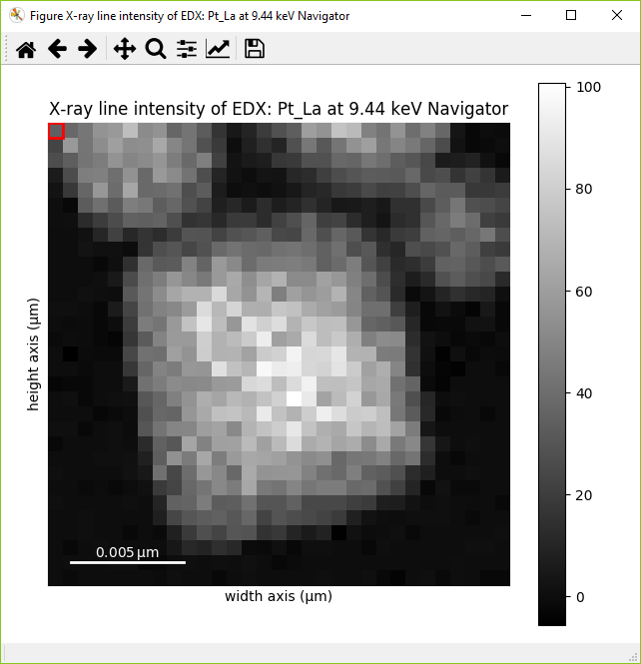
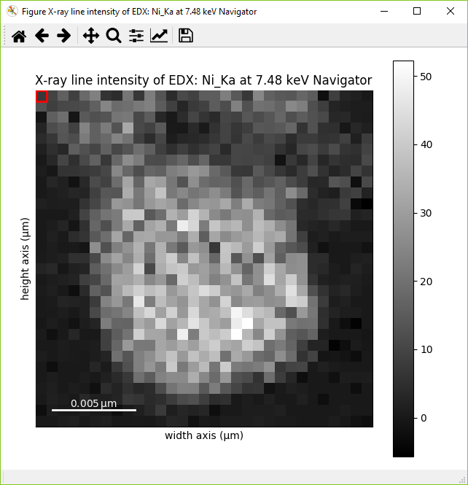
Hyperspy – Getting Intensities

Slide 13
Hyperspy - Quantification-K_Factors
Requires list of K-factors in same order as image stack.
K-factors based on Mass units.
Returns list of atomic (or weight) percent maps for each element.

Slide 14
Errors in quantification
Error in Cliff-Lorimer factor
We have already mentioned that calculated k-factors may have an error of ±20%. If you want very accurate results you should always check with a standard but you will still be limited by X-ray statistics.
Error in X-ray intensity
You are measuring a Gaussian peak and therefore the standard deviation will be $\sqrt{n}$ and the relative error with a 95% confidence level would be $\frac{2\sqrt{n}}{n}∗100\%$. Even if you have 10,000 counts in each peak that still gives a relative error of 2%.
Always think about the error in your quantification…

Slide 15
Absorption Correction
STEM
Probe
Detector
$$\frac{I_{A}}{I_{A0}}=e^{−{\left.\frac{μ}{ρ}\right]}^{A}ρl}$$
Absorption along path l
θ
z
Integrated absorption of all paths along the beam direction
z$.cosecθ$
$$\frac{I_{A}}{I_{A0}}=\int_{0}^{t}{e^{−{\left.\frac{μ}{ρ}\right]}^{A}ρl\left(z\right)}dz}$$
t
For a thin film
$\frac{I_{A}}{I_{A0}}=\int_{0}^{t}{e^{− {\left.\frac{μ}{ρ}\right]}^{A}ρzcosecθ}dz}=\frac{1}{{\left.ρ\frac{μ}{ρ}\right]}^{A}}cosecθ(1−e^{− {\left.\frac{μ}{ρ}\right]}^{A}ρtcosecθ}$)
$$ACF=\frac{{\left.\frac{μ}{ρ}\right]}^{A} (1−e^{−{\left.\frac{μ}{ρ}\right]}^{B}ρtcosecθ}\text{) }}{{\left.\frac{μ}{ρ}\right]}^{B} (1−e^{−{\left.\frac{μ}{ρ}\right]}^{A}ρtcosecθ}\text{) }}$$
$$\frac{C_{A}}{C_{B}}={(ACF)k}_{AB}\frac{I_{A}}{I_{B}}$$

Slide 16
Quantification – Single element methods
$$I_{α}=\{σ_{α}Γ_{α}ω_{α}\}\left\{\frac{C_{A}N_{0}ρ}{A_{A}}\right\}N_{e}t\left\{ε_{α}\frac{Ω}{4π}\right\}$$
$$I_{α}=\{σ_{α}Γ_{α}ω_{α}\}\left\{\frac{C_{A}N_{0}ρ}{A_{A}}\right\}N_{e}t\left\{ε_{α}\frac{Ω}{4π}\right\}$$
$$I_{α}=\{σ_{α}Γ_{α}ω_{α}\}n_{A}N_{e}t\left\{ε_{α}\frac{Ω}{4π}\right\}$$
$$C_{A}=ζ_{A}\frac{I_{A}}{N_{e}ρt}$$
$${σ_{A}n}_{A}=\frac{I_{A}}{N_{e}t}$$
$$ζ_{A}=\{σ_{α}Γ_{α}ω_{α}\}\left\{\frac{N_{0}}{A_{A}}\right\}\left\{ε_{α}\frac{Ω}{4π}\right\}$$
$$\frac{1}{σ_{A}}= \{σ_{α}Γ_{α}ω_{α}\} \left\{ε_{α}\frac{Ω}{4π}\right\}$$
Zeta-factor
Cross-section
Watanabe et al. Ultramic. (1996) 65, 187-198
Watanabe & Williams J. Microsc. (2006) 221, 89-109
K. E. MacArthur et al. Microsc. Microanal. 22 (2016) 71–81.

Slide 17
Quantification-zeta_Factors
Requires list of zeta-factors in same order as image stack.
zeta-factors based on Mass units.
Returns a list of atomic (or weight) percent maps for each element and the mass thickness map for the sample.

Slide 18
Quantification-cross_section
Requires list of experimental cross_sections in same order as image stack.
Cross sections based on atomic units.
Returns a list of atomic percent maps for each element.
Returns list of the number of atoms per pixel maps for each element.

Slide 19
Quantification - Tips
Both zeta_factors and cross_sections require a calculation of the electron fluence. Therefore the following parameters must be set:
s.set_microscope_parameters(beam_current = 0.0432)
s.set_microscope_parameters(live_time = 0.003024)
If an element is repeated in the stack of images e.g. Ka and Kb it must be repeated in the list of factors. – This means you can specify a different quantification for each sub-shell if wanted.

Slide 20
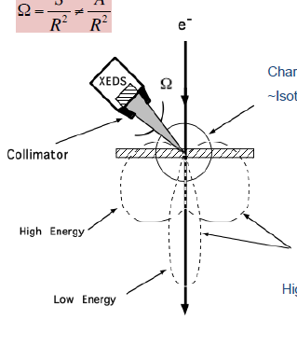
Why are X-ray detectors always above sample? - Bremsstrahlung
Characteristic
~Isotropic
Bremsstrahlung Process
Continuum
Highly Anisotropic
Bremsstrahlung produced due to inelastic scattering of electron by nucleus (predominantly).
Bremsstrahlung is highly forward peaked.

Slide 21
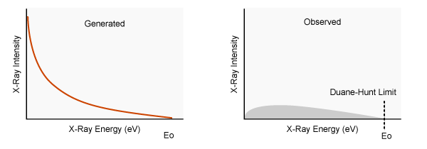
Bremsstrahlung continued
Kramers’ Law

Slide 22
Limitations – (aka Topics we haven’t covered)
Have assumed thin film throughout, i.e. no fluorescence and no change in integrated flux with depth.
STEM
Probe
X-ray fluorescence
Secondary X-ray
Primary X-ray
In SEM have much more complicated matrix corrections.

Slide 23
Limitations – (aka Topics we haven’t covered)
For X-ray absorption, assume a point detector but X-ray detectors keep subtending larger solid angles.
Should we integrate over a range of take-off angles?

Slide 24
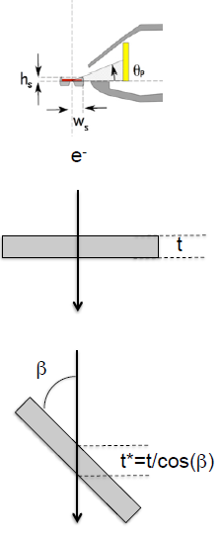
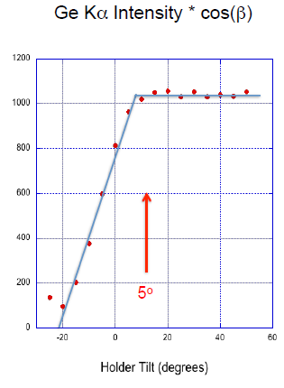
Limitations – (aka Topics we haven’t covered)
Collection solid angle may be fixed but ‘effective’ solid angle can change with holder / tilting of sample.
Important for spectra collected on E02 or if tilting on E01!

