Slide 1
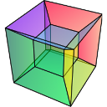
Introduction to Python and HyperSpy
Eric Prestat
Department of Materials, University of Manchester, Manchester, UK
SuperSTEM Laboratory, SciTech Daresbury Campus, Daresbury, UK

Slide 2
Objectives
Learn about Python and HyperSpy
The python scientific stack
Run python command in a jupyter notebook
Find the relevant documentation
Machine learning
Perform dimensionality reduction and signal unmixing
Model fitting
Create model, for example to fit EDS or EELS data
Big data analysis
Principle of out-of-core computation, “lazy” processing
Understand the logic of how to use Python and HyperSpy

Slide 3
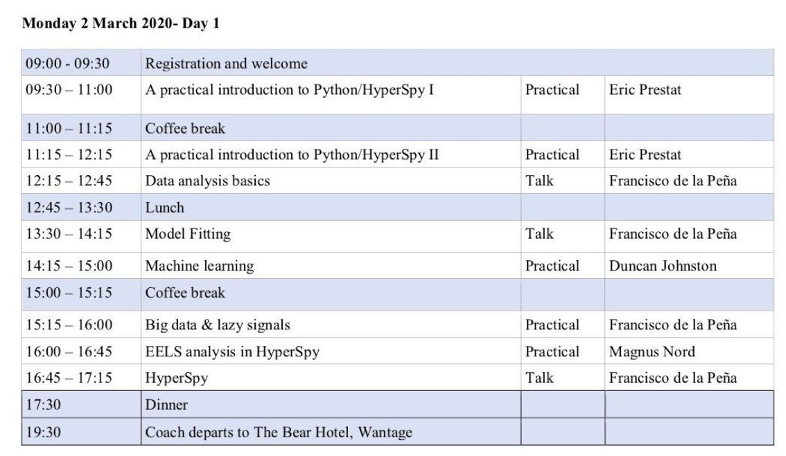
Agenda of today

Slide 4
What is this “Python” I have heard of?!
High level, general purpose programming language with "batteries included"
Simple enough for quick scripts; featured enough for complex projects
Used extensively on the web, in applications, and throughout science
Syntax emphasizes readability and explicitness
Very popular in the scientific community because of
interoperability with other languages
its powerful scientific libraries
its simplicity and dynamic nature
The Unexpected effectiveness of Python in Science, PyCon 2017
http://vanderplas.com/speaking.html

Slide 5
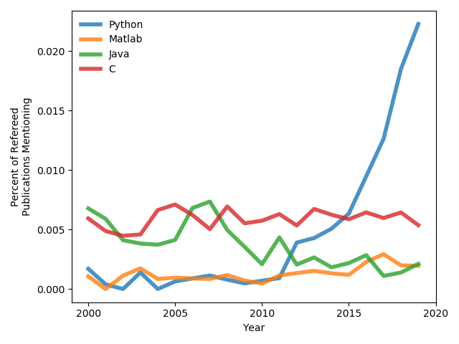
Why is Python so popular in the scientific community?
Interoperability with other languages
Simplicity and dynamic nature
Syntax emphasizes readability and explicitness
What does it mean?
Powerful scientific libraries
User becomes contributors
In the field of Astrophysics
The Unexpected effectiveness of Python in Science, PyCon 2017
http://vanderplas.com/speaking.html
Adapted from https://gist.github.com/jni
https://gist.github.com/jni/3339985a016572f178d3c2f18e27ec0d
Data from https://ui.adsabs.harvard.edu

Slide 6
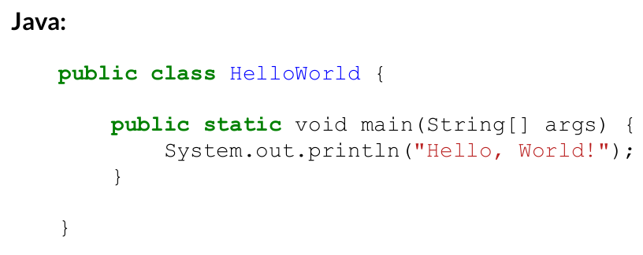
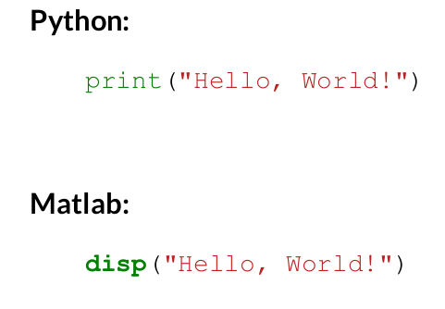
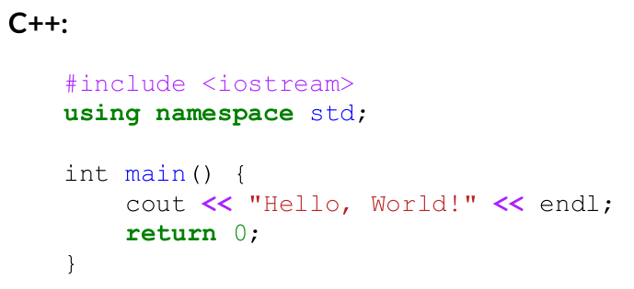
Simple and easy
No need for compilation, easy prototyping

Slide 7
Motivation to use HyperSpy
Makes it easy to operate on multi-dimensional and hyperspectral dataset, as you would on a single spectrum or image
Easy access to cutting-edge signal processing tools
Control of your data processing: no black boxes!
Provides facilities for easy access to proprietary software formats
Can be used in different environment
Jupyter notebook
Inside a script or a program
Through a GUI a la (limited functionalities ☹)

Slide 8
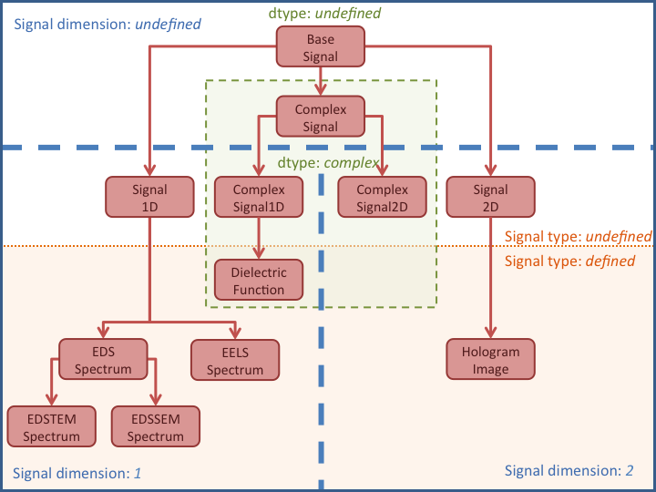
HyperSpy core concepts
Signal objects
Navigation and signal space
Plotting
Mapping operation
Generic signal type:
Signal1D, Signal2D
Specialised signal type:
EDS, EELS, etc.
“Spectrum” type dataset
“Image” type dataset

Slide 9
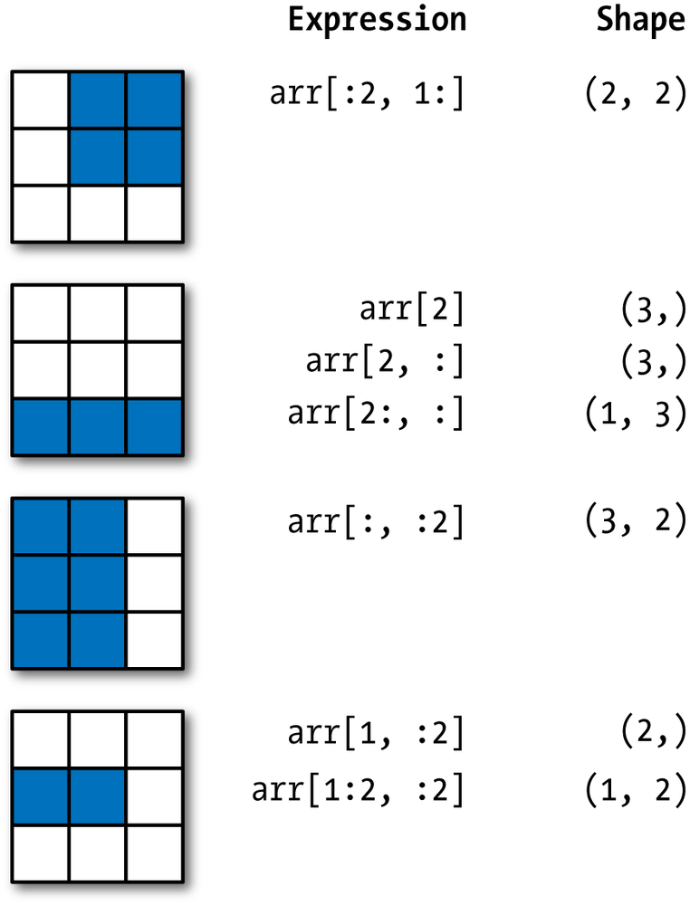
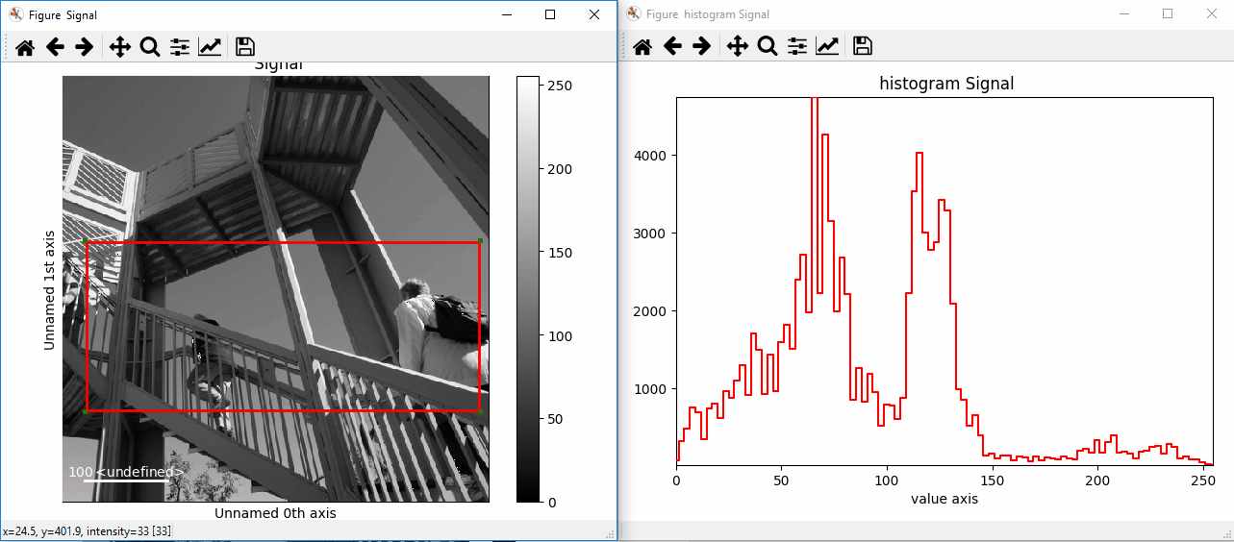
HyperSpy main features
Indexing and slicing
How to select the specific part of the dataset we are interesting in
Interactive operation and ROIs

Slide 10
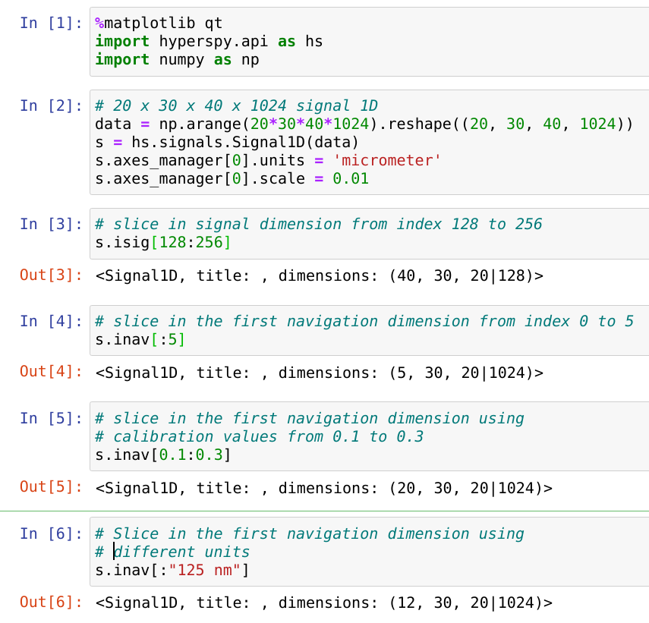
Indexing and slicing syntax
Indexing and slicing
How to select the specific part of the dataset we are interesting in
Follow Python syntax
Allow
Independent indexing of signal and navigation dimensions
Indexing in calibrated values (using decimal numbers)
Indexing with units (using string)

Slide 11
Motivation to use HyperSpy
EM Specialised data processing
EDS
Background removal
Net intensity extraction
Quantification (k-factor, ceta-factor, ionization cross section)
EELS
Background removal/core-loss intensity extraction
Model fitting
Dimensionality reduction and signal unmixing

Slide 12
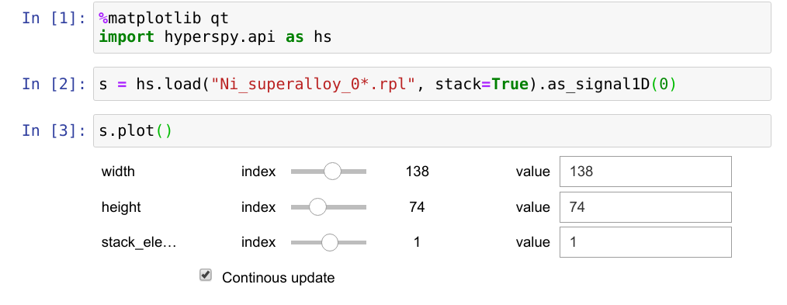
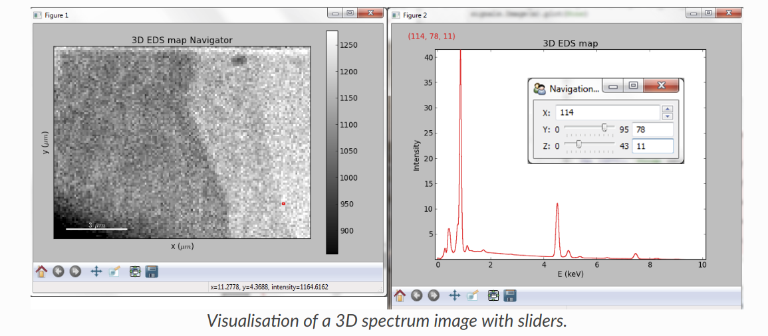
Syntax
Example to load a stack of EDS spectrum image (FIB slice and view)

Slide 13
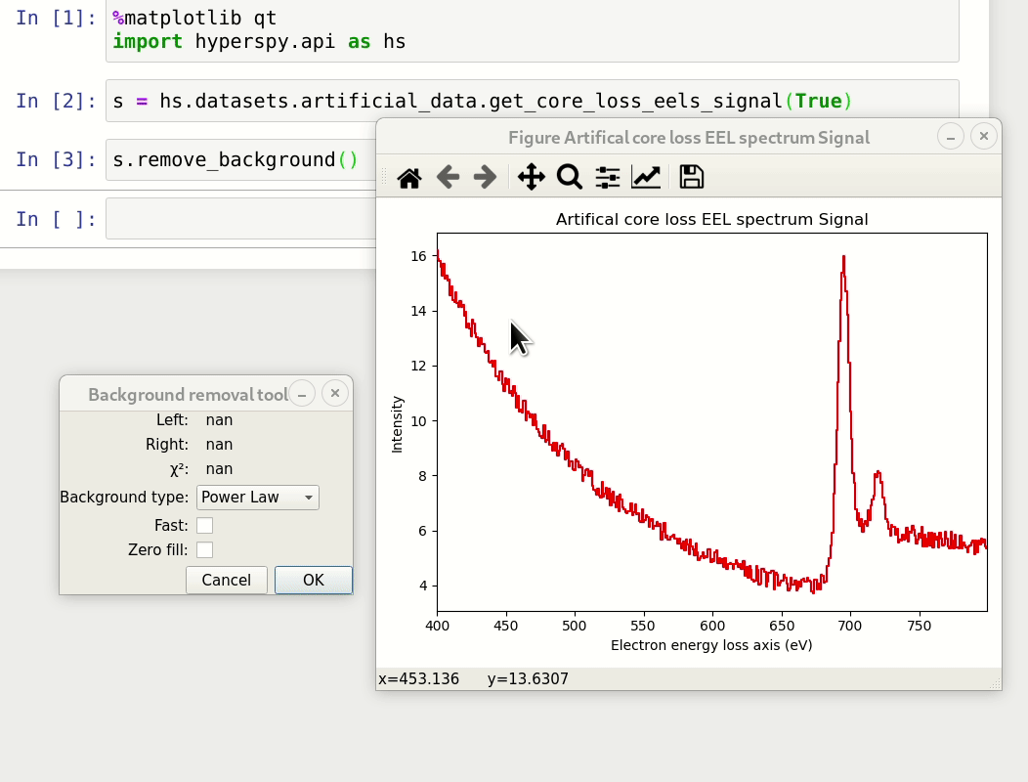
Interactive tools
Remove background of an EELS

Slide 14
Intro session
Use the notebook
Run python code
Access documentation within the notebook (docstring)
Create signal and loading data
Read/modify calibration and metadaa
GUIs and visualisation
Indexing and slicing data
ROIs and interactive operaiton

Slide 15
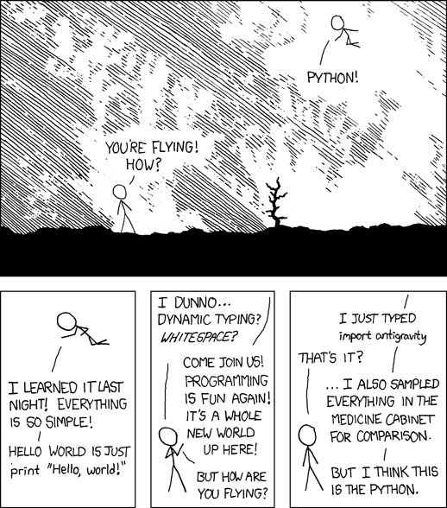
https://xkcd.com/353/

