Slide 1


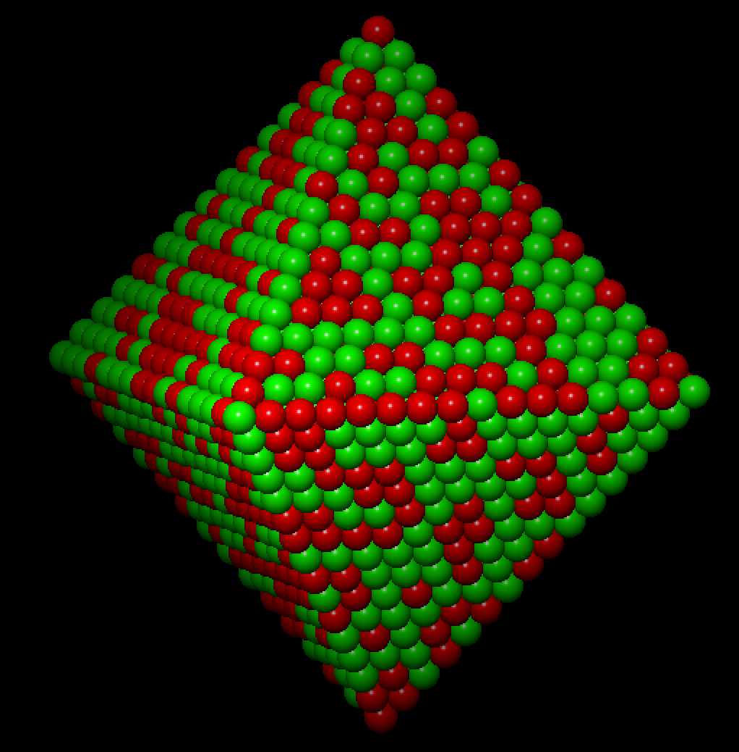
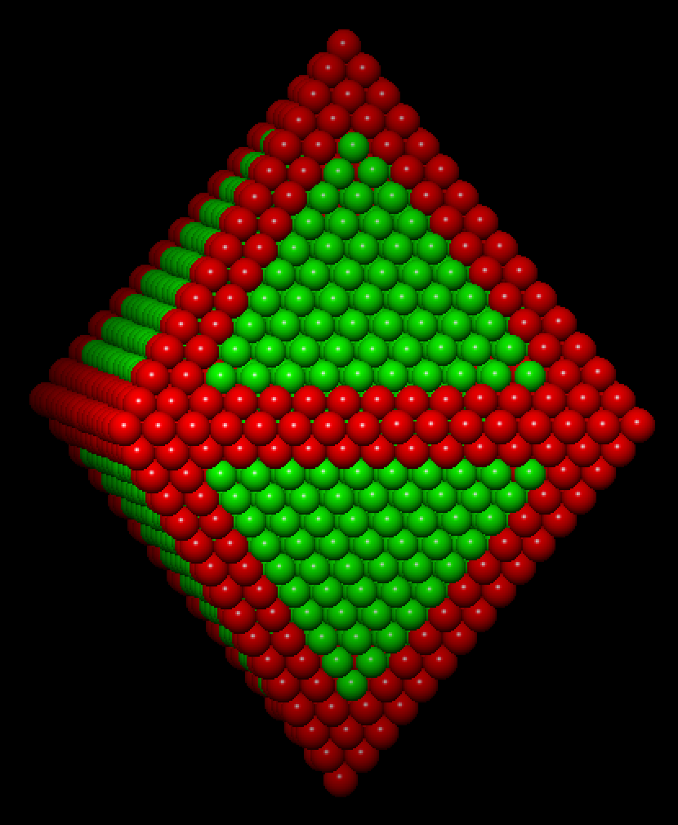
EDX Data Analysis with Hyperspy
Katherine E. MacArthur
Thursday 12th May

Slide 2
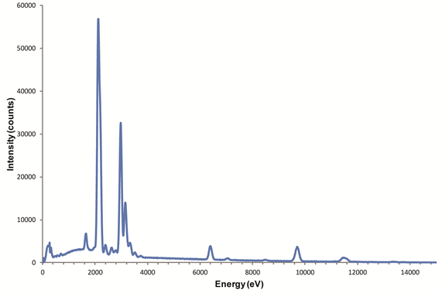
Contents
Nomenclature of X-Ray Lines
Data Formats and Loading Data
Extracting Intensities
Limitations of EDX
Achieving good spectra: Importance of re-binning
EDX Quantification
Advanced Analysis:
  Absorption Correction
  Atomic Resolution EDX Analysis

Slide 3
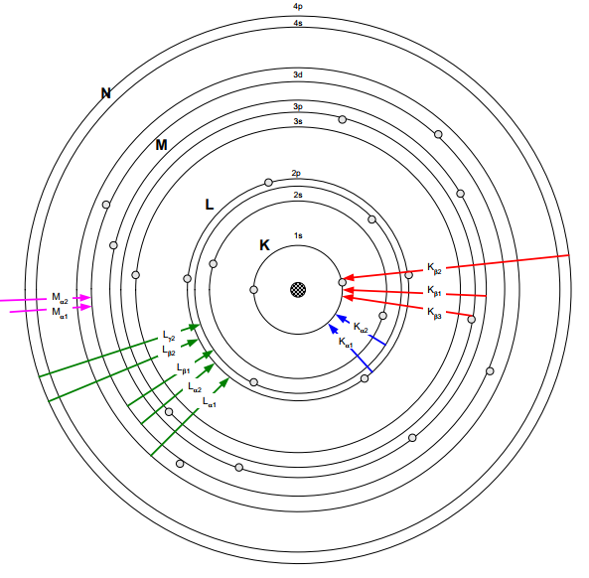
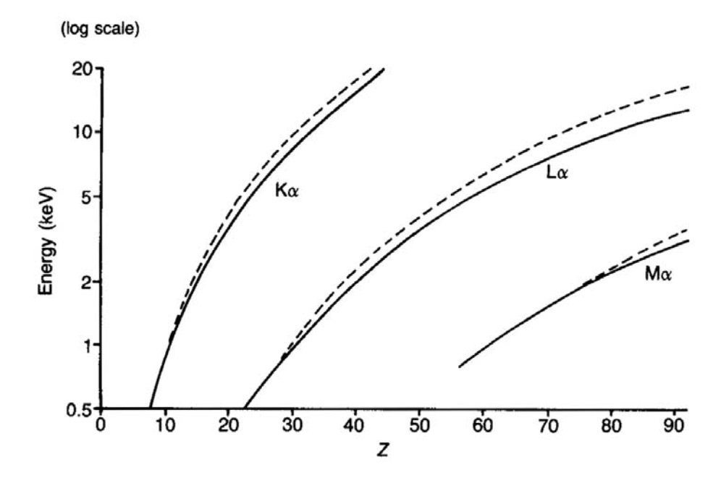
Nomenclature of X-Ray Lines
K-lines
  Highest energy
  Electron finishes in the K-shell.
K_{ɑ} lines are lower energy than K_{β} lines.

Slide 4
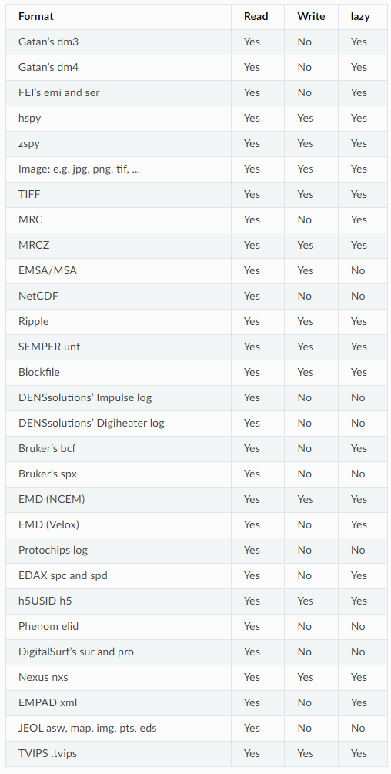
Data Formats
Read capability from most commercial EDX software – (Oxford Instruments format coming).
Data format based on multidimensional arrays of numbers known as numpy arrays.
A distinction is made between navigations axis and signal axis.
Signal1D e.g. EDX, EELS
<Signal1D, title: , dimensions: (x, y | E)

Slide 5
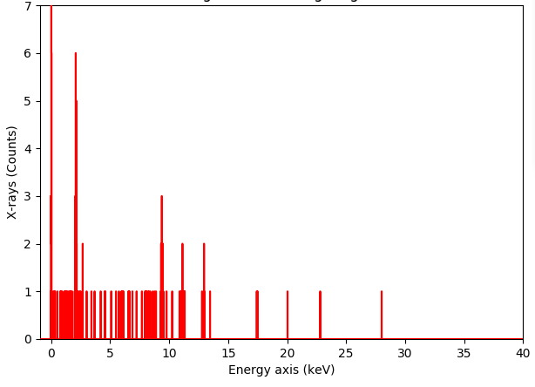
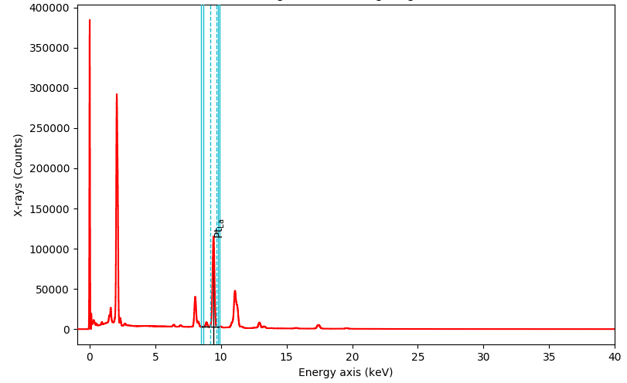
Loading Data
Importing raw EDX data looks rather different from how you see it during acquisition in the software.
Low counts per pixel, particularly for atomic-scale data, is a frequent problem.
Detector noise lines can be seen which are normally cut out by the commercial software.
Check all calibrations and necessary elements have transferred across to the metadata.
Noise peak!
Notes:
The SDD is a completely depleted volume of silicon in which an arrangement of increasingly negatively biased rings drive the electrons generated by the impact of ionising radiation towards a small readout node in the centre of the device. The time needed for the electrons to drift is much less than 1 µs.

Slide 6
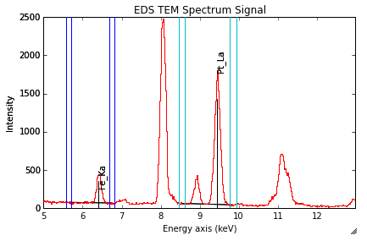
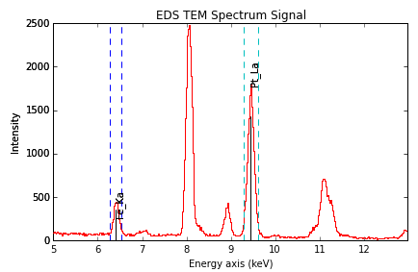
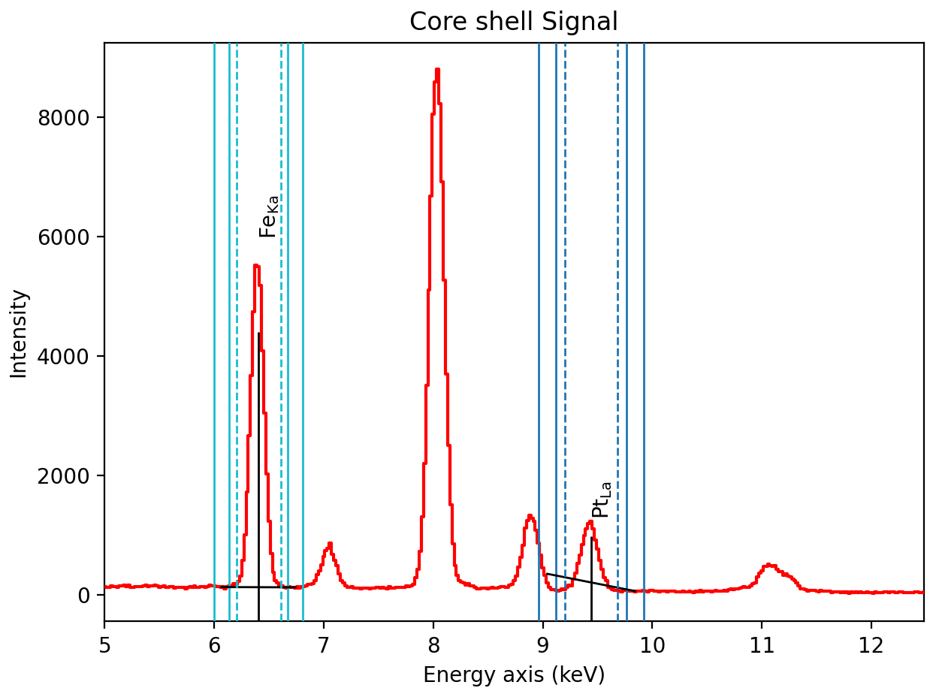
Subtracting Intensities
Background Subtraction
Integration
Default: No background subtraction and 1 sigma standard deviation of peak for integration.
Best applied to the higher energy areas and TEM/thin specimen.
Performs better at lower signal to noise
We assume a linear background between two measured background locations.
Important that the right values are selected for background windows otherwise erroneous fitting occurs.
Notes:
The SDD is a completely depleted volume of silicon in which an arrangement of increasingly negatively biased rings drive the electrons generated by the impact of ionising radiation towards a small readout node in the centre of the device. The time needed for the electrons to drift is much less than 1 µs.

Slide 7
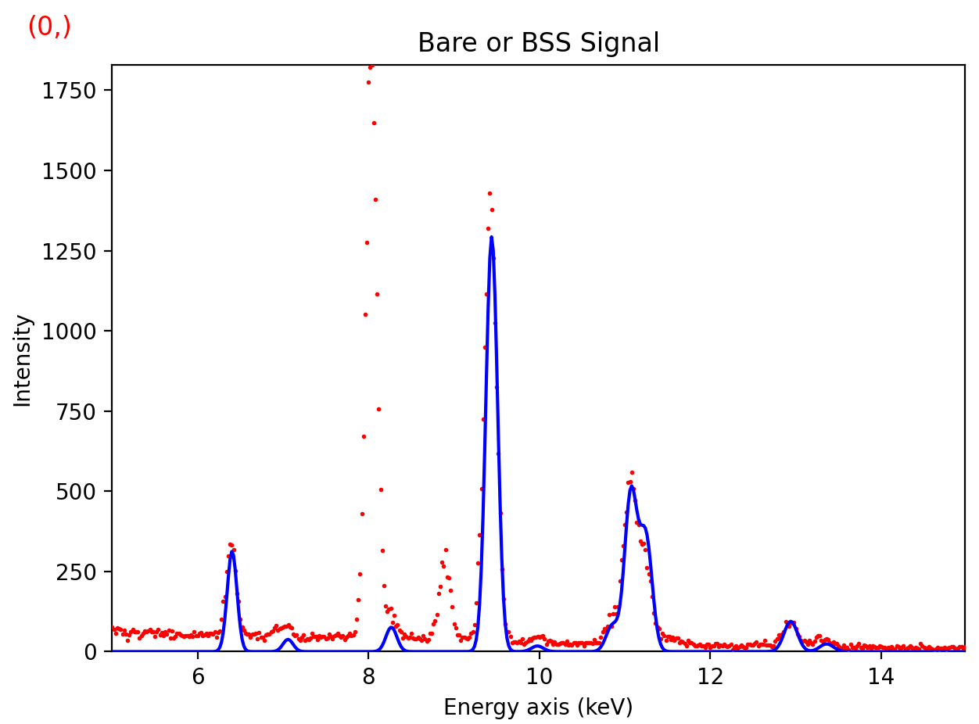
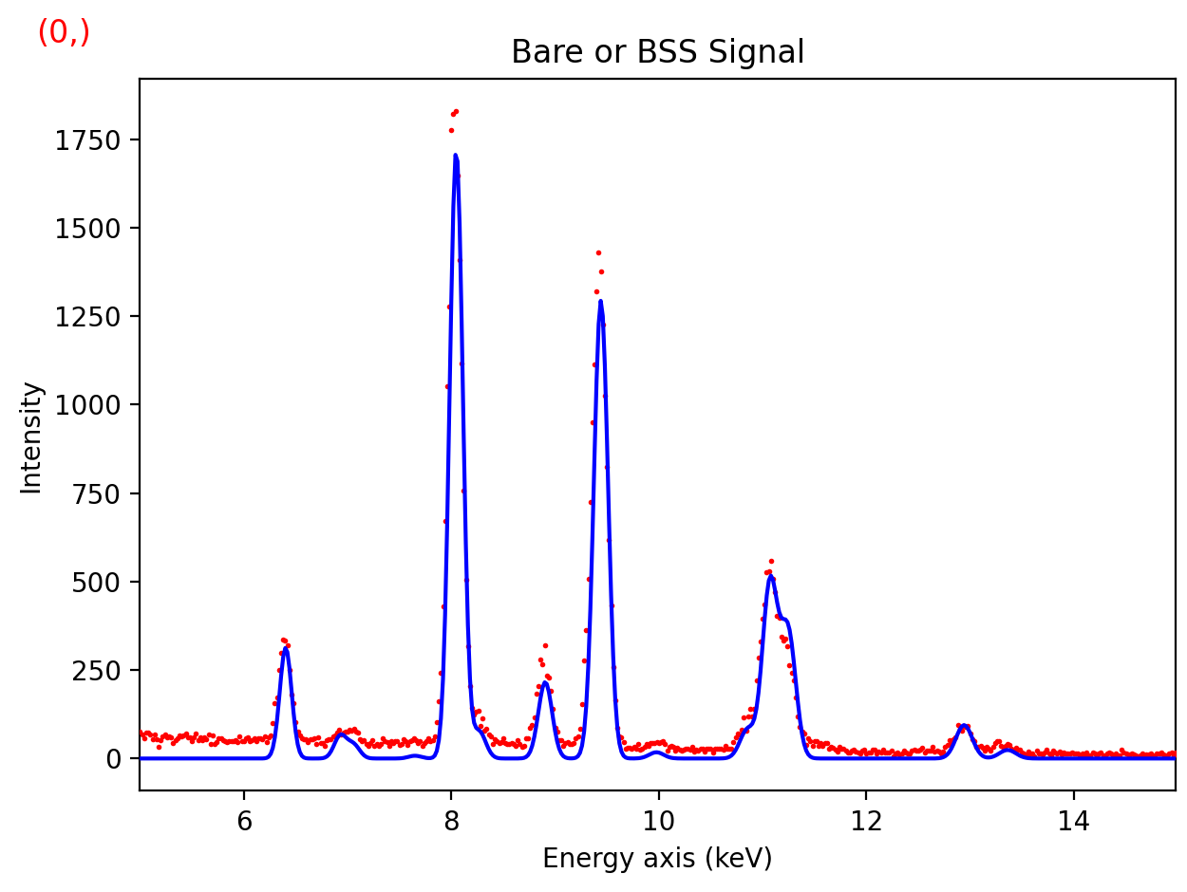
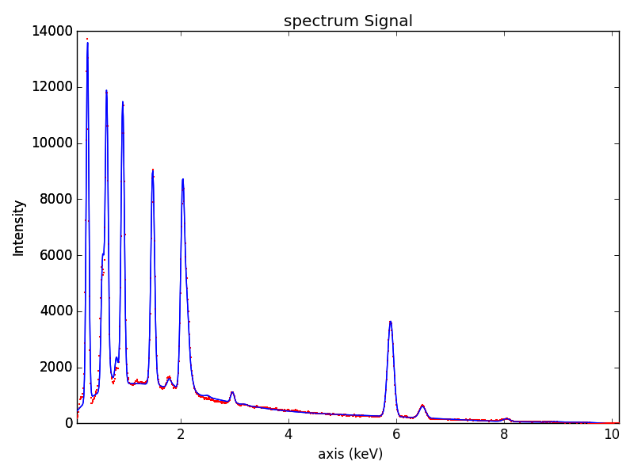
Subtracting Intensities: Model Fitting
Performs better for thicker specimen and lower energy X-ray lines.
Hyperspy has in-built knowledge of the expected locations for each X-ray line and ratios between Ka and Kb.
Need to make sure every line is included. Can add families of lines by default.
Important to get a good starting model and have higher signal-to-noise.
Multifit function can perform the model fitting over a whole spectrum image (can be time consuming).
Notes:
The SDD is a completely depleted volume of silicon in which an arrangement of increasingly negatively biased rings drive the electrons generated by the impact of ionising radiation towards a small readout node in the centre of the device. The time needed for the electrons to drift is much less than 1 µs.

Slide 8
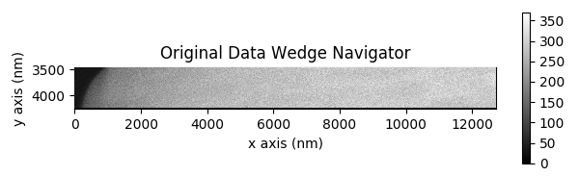
Using Window Integration : Importance of Re-binning your data!
Notes:
The SDD is a completely depleted volume of silicon in which an arrangement of increasingly negatively biased rings drive the electrons generated by the impact of ionising radiation towards a small readout node in the centre of the device. The time needed for the electrons to drift is much less than 1 µs.

Slide 9
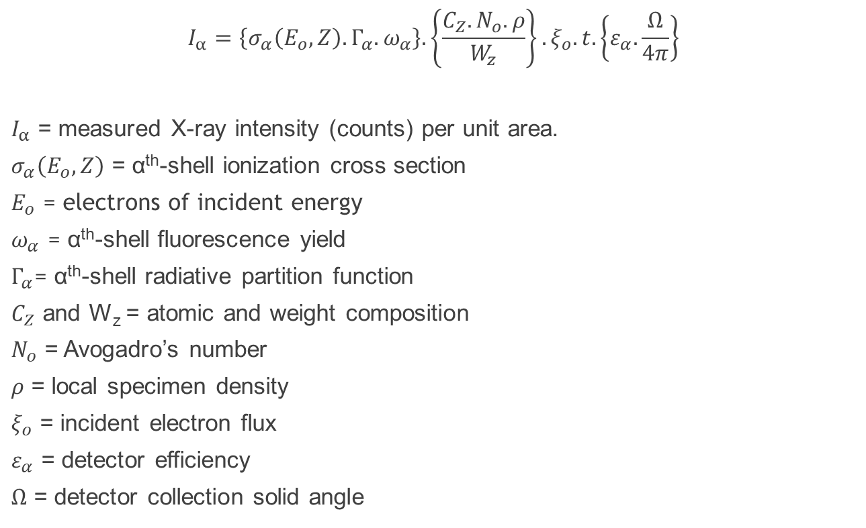
Characteristic X-ray Emission from a “thin film”
Sample
$$I_{α}=\left\{σ_{α}\left(E_{o},Z\right).Γ_{α}.ω_{α}\right\}.\left\{\frac{C_{Z}.N_{o}.ρ}{W_{z}}\right\}.ξ_{o}.t.\left\{ε_{α}.\frac{Ω}{4π}\right\}$$
$I_{α}$ = measured X-ray intensity (counts) per unit area.
$σ_{α}\left(E_{o},Z\right)$ = α^{th}-shell ionization cross section
$E_{o}$ = electrons of incident energy
$ω_{α}$ = α^{th}-shell fluorescence yield
$Γ_{α}$= α^{th}-shell radiative partition function
$C_{Z}$ and W_{z} = atomic and weight composition
$N_{o}$ = Avogadro’s number
$ρ$ = local specimen density
$ξ_{o}$ = incident electron flux
$ε_{α}$ = detector efficiency
$Ω$ = detector collection solid angle
Detector
X-Ray Line

Slide 10
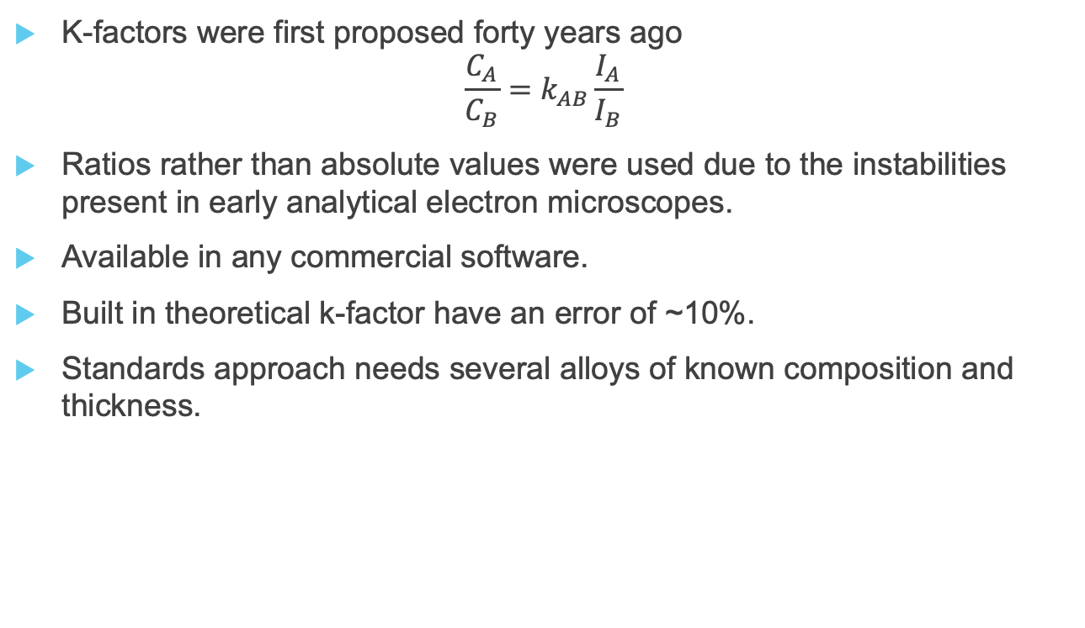
EDX Quantification
K-factors were first proposed forty years ago
$$\frac{C_{A}}{C_{B}}=k_{AB}\frac{I_{A}}{I_{B}}$$
Ratios rather than absolute values were used due to the instabilities present in early analytical electron microscopes.
Available in any commercial software.
Built in theoretical k-factor have an error of ~10%.
Standards approach needs several alloys of known composition and thickness.
Cliff & Lorimer J. Microsc. (1975) 103, 203-207
Watanabe & Williams J. Microsc. (2006) 221, 89-109

Slide 11



EDX Quantification
The ζ-factor method uses pure single element standards.
Assuming x-ray absorption and fluorescence are negligible.
is the factor connecting I_{A} to ρt and C_{A} is the weight fraction of A.
Watanbe et al. Ultramic. (1996) 65, 187-198
Watanabe & Williams J. Microsc. (2006) 221, 89-109

Slide 12



EDX Cross Sections
Similar to the ζ-factor method as it uses pure element standards.
Assuming x-ray absorption and fluorescence are negligible.
K. E. MacArthur et al. Microsc. Microanal. 22 (2016) 71–81. doi:10.1017/S1431927615015494.

Slide 13
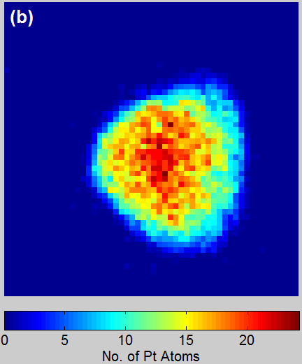
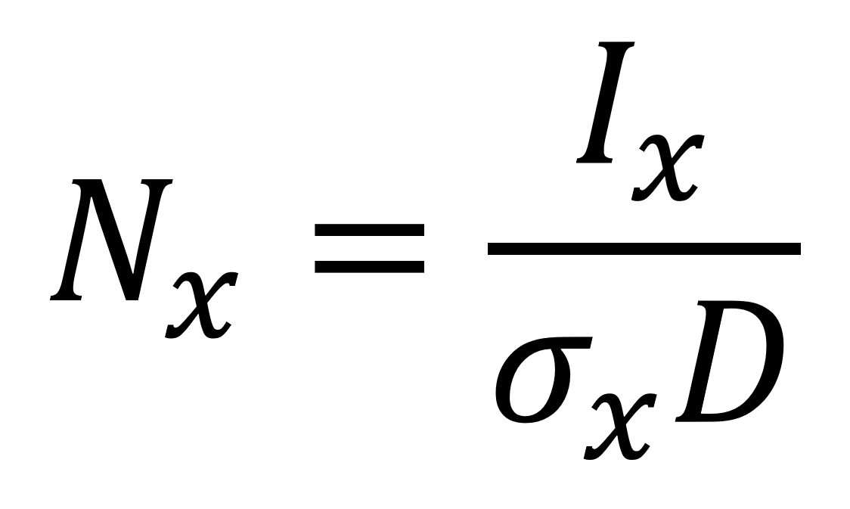
EDX Cross Sections
1 barn = 10 ⁻²⁸ m²
Metal | (atoms/nm³) | EDX (b) | EELS (kb) | ADF (Mb)
Pt | 66.41 | 5.42 | 0.323 | 2.40
Co | 90.28 | 2.89 | 1.334 | 0.495
K. E. MacArthur et al. Microsc. Microanal. 22 (2016) 71–81. doi:10.1017/S1431927615015494.

Slide 14
Steps for Quantification
Need:
  Intensities from s.get_lines_intensities
  Elements set in metadata
  Beam current (zeta and EDX cross sections)
  Sample thickness (for cliff lorimer and absorption correction).
Returns:
  Composition-stack of elements in atomic percent
  Mass thickness (zeta)
  Number of atoms –stack (cross sections)

Slide 15
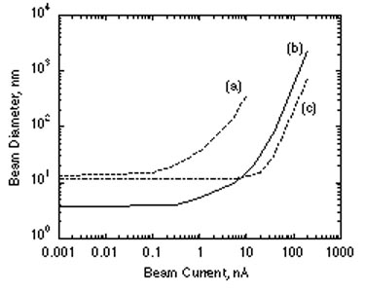
Limitations of EDX Quantification
Poor counting statistics. = Higher probe currents, longer dwell times.
Limited to high z numbers.
Low energy resolution.
Careful background subtraction and peak integration.
If using standards, integration windows need to be the same.

Slide 16
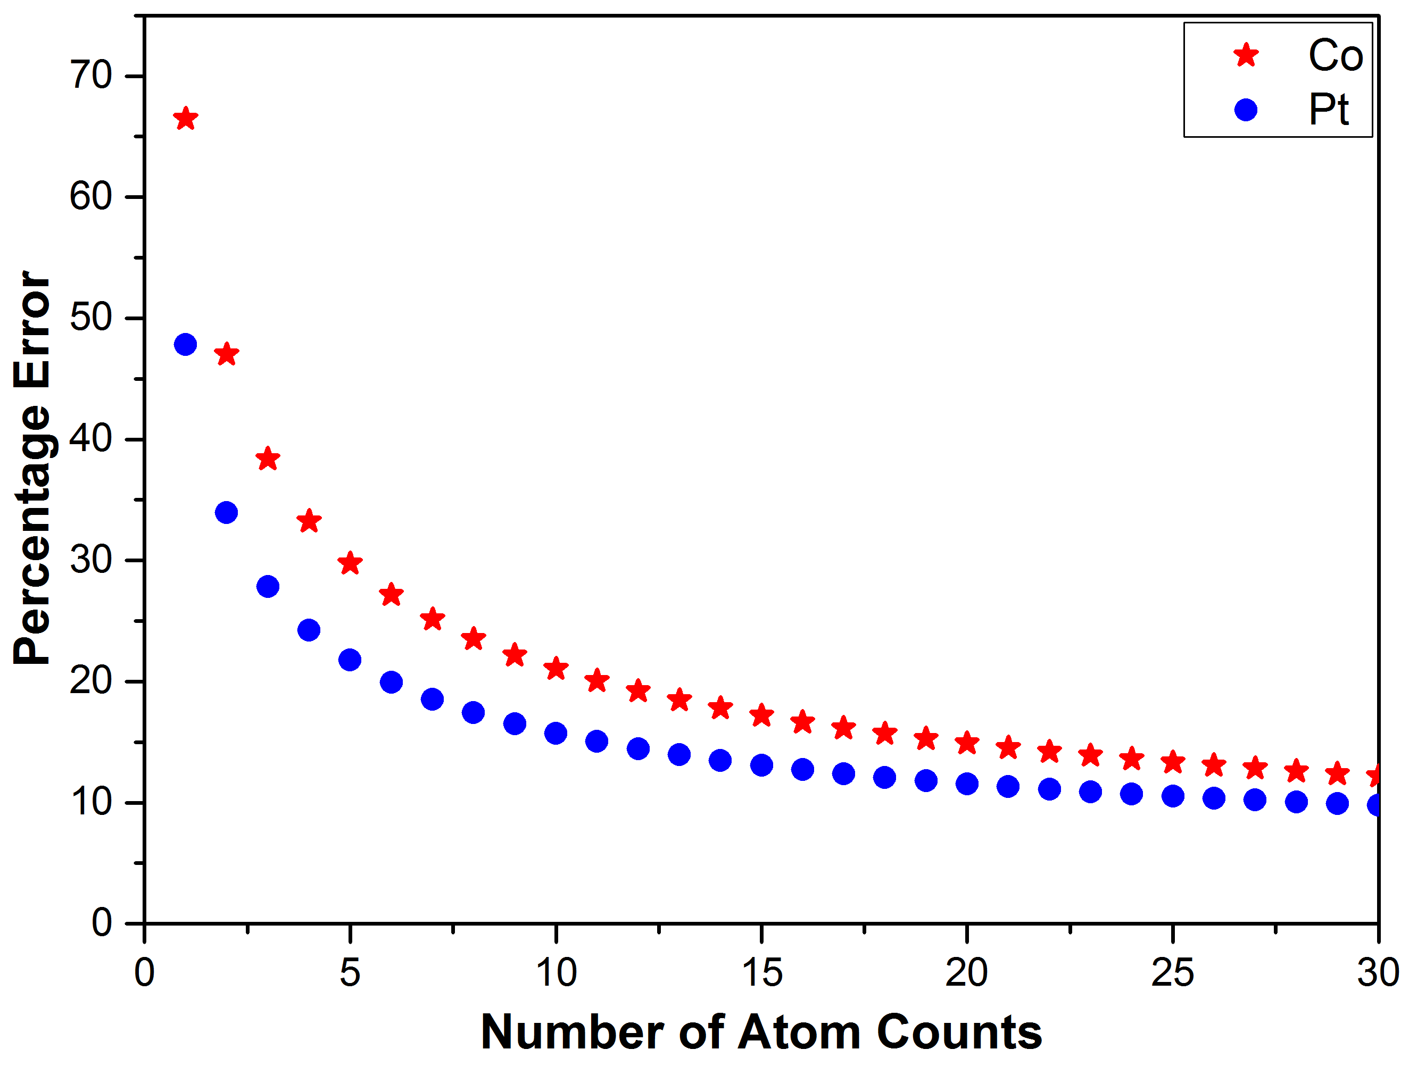
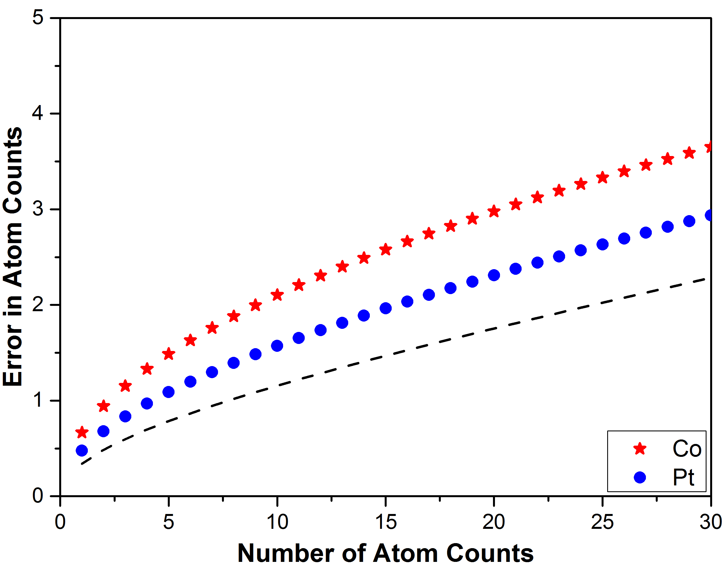
Accuracy of Individual Column Analysis?
The limiting source of error in counting statistics.
Relative error, decreases with increasing thickness because the total raw counts increases.
Single atom sensitivity is not quite possible at sample surfaces where we’re really interested.
K. E. MacArthur et al. J. Mater. Sci. Technol. 32 (2016) 248–253. doi:10.1080/02670836.2015.1133021.

Slide 17
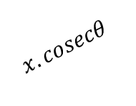
Absorption Correction
STEM
Probe
Detector
θ
x
t
$$x.cosecθ$$
Assumptions:
That x-ray absorption is uniform in each layer of the sample. – reasonable as long as the sample is sufficiently thin.
Uniform thickness, t.
X-rays are emitted uniformly in all directions and those that reach the detector travel by the shortest linear route to the detector.
The sample is sufficiently thin that θ doesn’t vary greatly with x.

Slide 18
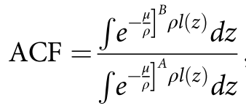
Absorption Correction
STEM
Probe
Detector
θ
x
t
$$x.cosecθ$$
l(z) is the path length to the detector as a function of sample thickness z.
Slater, T. J. A. et al. Nanoparticles. Microsc. Microanal. 2016, 22, 440–447.

Slide 19
Absorption Correction
Assumptions:
  Only one detector
  Uniform sample thickness
  Uniform composition
  Zero holder shadowing to point detector
Watanabe & Williams, J. Microscopy 2006, 221, 89–109.

Slide 20
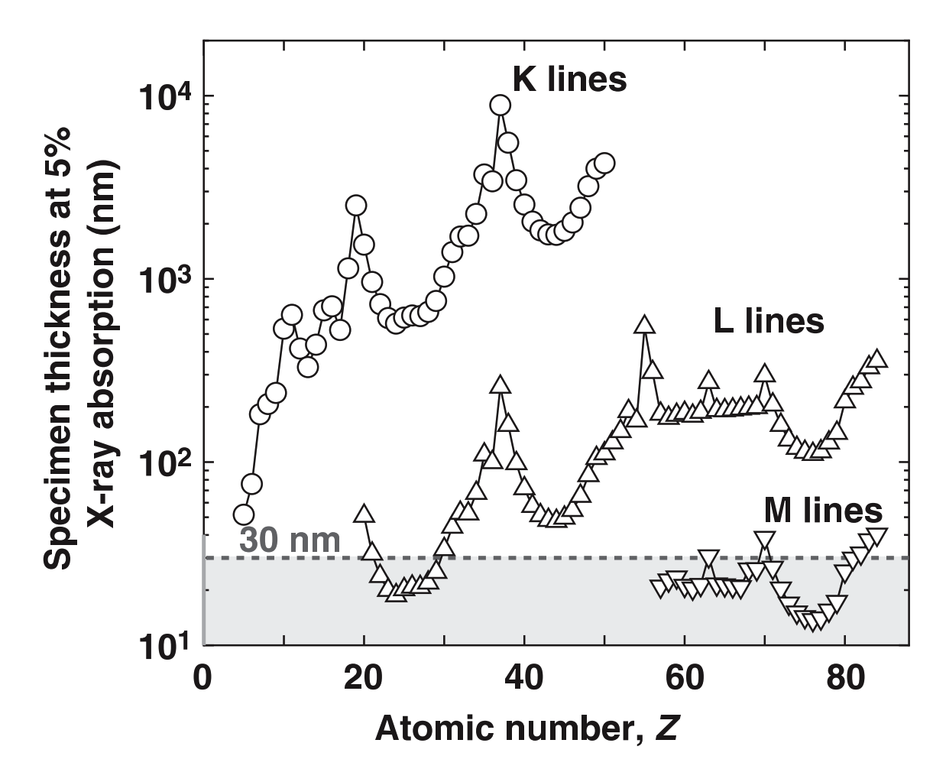
Absorption Correction
Watanabe & Williams, J. Microscopy 2006, 221, 89–109.

Slide 21
Absorption Correction
What about Multiple detector geometries?

Slide 22
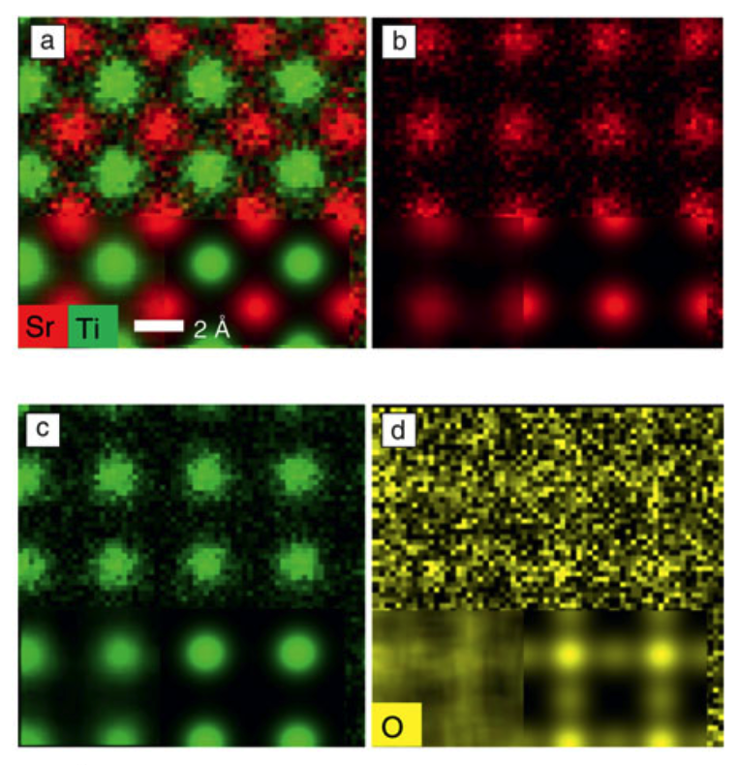
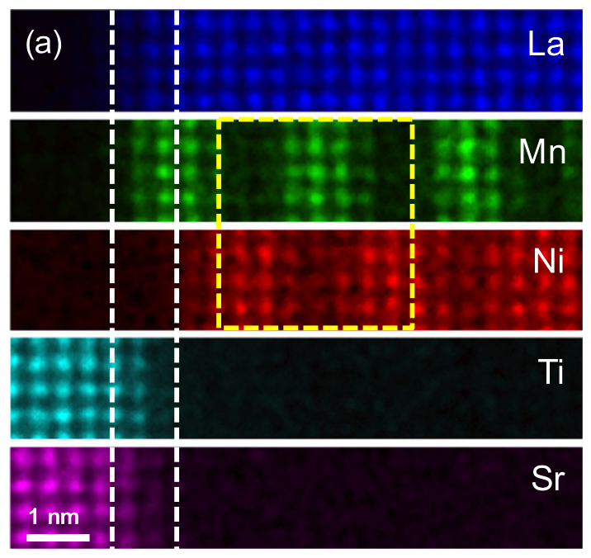
Atomic Resolution Energy Dispersive X-ray Mapping
L. Allen, et al. MRS Bulletin, 37(1), (2012) 47-52
J-H Kwon et al. Semicond. Sci. Technol. 32 (2017) 014002
Notes:
The possibility of carrying out EDX mapping at atomic resolution has now become possible due to the combined advancements of:
Microscope stability,
Aberration correction,
Silicon Drift Detectors
The information such high resolution maps provide has applications in studying interfaces and grain boundarys, nanoparticles among others. However, what we really need/want is quantitative information on how the composition changes at the atomic scale.

Slide 23
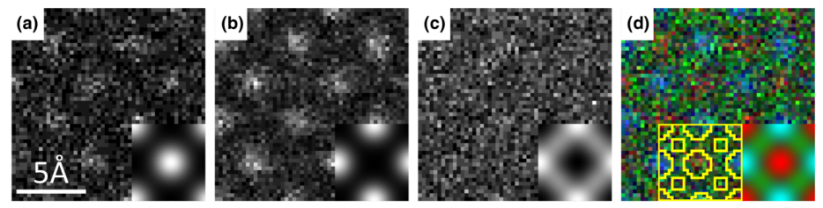
Is Quantitative Atomic EDX Possible?
Sr-K
Ti-K
O-K
Composite
G. Kothleitner, et al. Phys. Rev. Lett. 112 (2014) 85501.
Notes:
G Kothleitner and coworkers have demonstrated that an exact match between experiment and simulations can be achieved on an absolute scale.
However we need to know a structure to simulate in order to get such a match.
When trying to answer a Materials science problem we are frequently in the situation where the sample structure and composition are un-known.
The number of possible structures to simulated becomes intractably large.

Slide 24
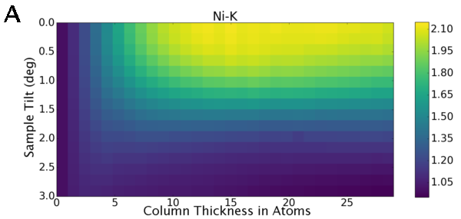
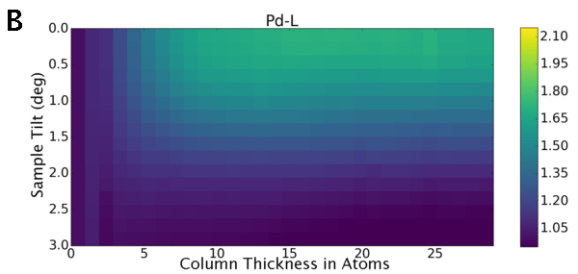
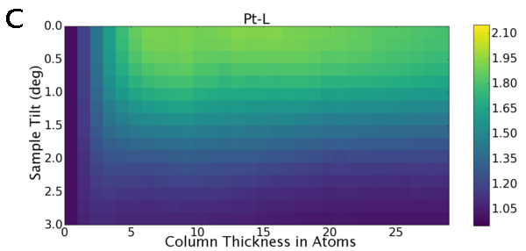
Effect of Electron Channelling
K.E. MacArthur et al. Ultramicroscopy. (2017) 182, 264–275

Slide 25
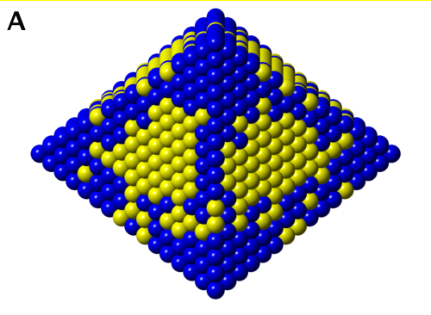
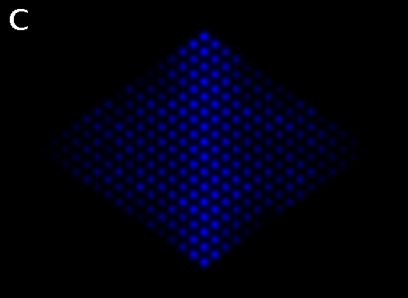
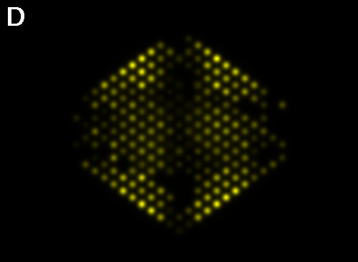
Effect of Channelling in a PtNi Nanoparticle
Pt-L
Ni-K
Input
Output
ADF
Difference
K.E. MacArthur et al. Ultramicroscopy. (2017) 182, 264–275

Slide 26
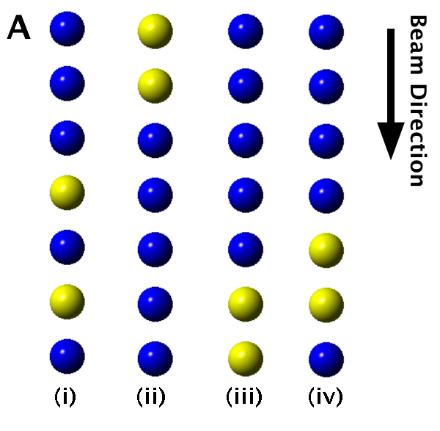
Configuration Effects
K.E. MacArthur et al. Ultramicroscopy. (2017) 182, 264–275

Slide 27
Configuration Effects
K.E. MacArthur et al. Ultramicroscopy. (2017) 182, 264–275

Slide 28
Effect of Sample Tilt
K.E. MacArthur et al. Ultramicroscopy. (2017) 182, 264–275

Slide 29
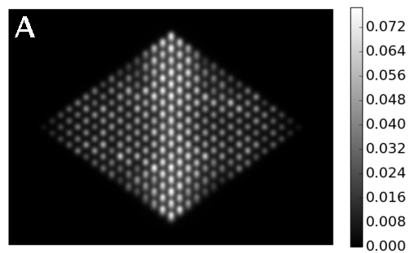
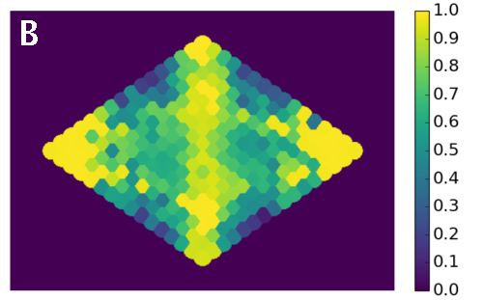
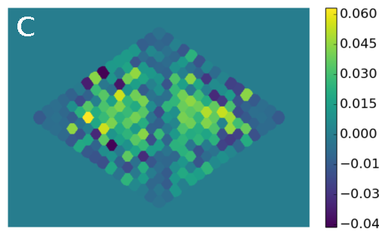
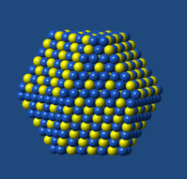
Applying 2 Degree Tilt to Particle
K.E. MacArthur et al. Ultramicroscopy. (2017) 182, 264–275

Slide 30
Summary for Good EDX
High probe currents and dwell times for larger counts = better statistics.
Eucentric height, maximise visibility to the detector.
Low dead time to minimise artefacts.
Ideally quantify using k-lines.
Absorption correction needed particularly for thicker samples.
Keep integration windows the same between calibration standards and samples.
Be wary of channelling when examining atomic EDX maps.

